Slide 1
Neural Networks
Building Artificial Brains

Slide 2
Crash Course in Neurobiology
Synapses
Dendrites
Nerve cells, a.k.a Neurons, are specialized to send and receive signals.
They contain conductive materials & structures to do so.
Important Parts
Axon – sends signals
Dendrites – pick up signals
Synapses – connections; control signal flow
Synapses…
Allow us to learn by changing over repeated stimulation
Increase or decrease the strength of passing signals
Most-used synapses increase signal strength
Less-used synapses reduce signal strength
Synapse strengths are changed through error correction
Axon

Slide 3

Brains!
Some Brain Statistics
~85 billion individual neurons
Heavily interconnected network
(~7,000 synapses per neuron)
Signal rate of ~10 ms / transmission
Typical CPU is faster, but the brain will do far more tasks in parallel
Draws ~20 watts of power
One of the largest artificial neural networks:
(Stanford, 2013)
~20 million neurons
~11 billion synapses
~4 orders of magnitude short

Slide 4
Creating artificial Neural Networks
We can connect multiple neurons together to create networks.
Neural Networks can be used for general purpose problem solving.
In theory, with enough neurons in the proper configuration we could solve any problem.
…That does not mean we should, of course.
We will configure our networks into multiple layers, where each neuron in a layer will receive as input the output from every neuron in the previous layer.
Input
Layer 0
Layer 1
Output
N
CanGoLeft()
N
DriveLeftLeg(float)
N
CanGoForward()
N
DriveRightLeg(float)
N

Slide 5

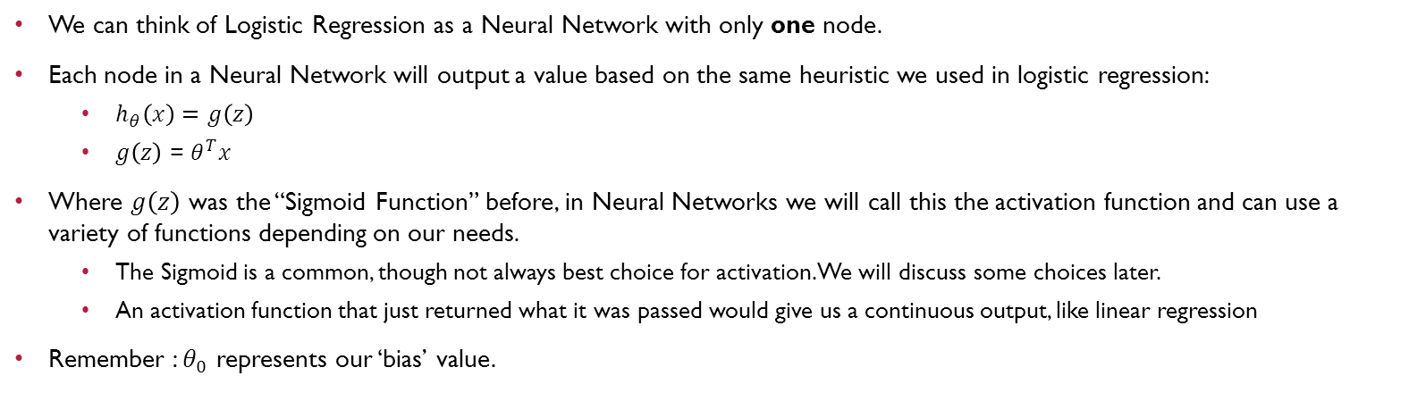


Logistic Regression to Neural Networks
We can think of Logistic Regression as a Neural Network with only one node.
Each node in a Neural Network will output a value based on the same heuristic we used in logistic regression:
$h_{θ}\left(x\right)=$ $g\left(z\right)$
$g\left(z\right)$ = $θ^{T}x$
Where $g\left(z\right)$ was the “Sigmoid Function” before, in Neural Networks we will call this the activation function and can use a variety of functions depending on our needs.
The Sigmoid is a common, though not always best choice for activation. We will discuss some choices later.
An activation function that just returned what it was passed would give us a continuous output, like linear regression
Remember : $θ_{0}$ represents our ‘bias’ value.
$$θ_{0}∗1$$
$$θ_{1}∗X_{1}$$
N
Output value
$$θ_{2}∗X_{2}$$

Slide 6
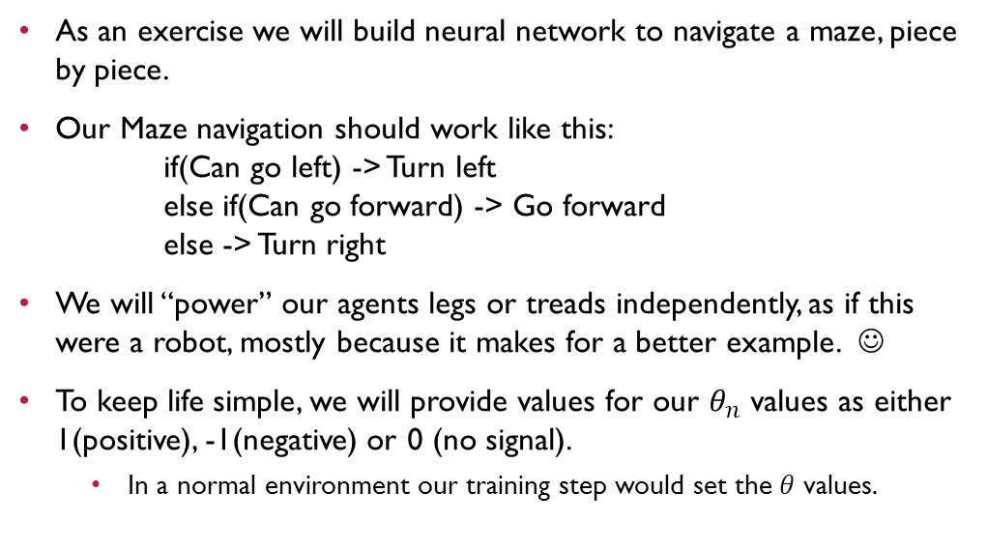
Umm.. Okay, but how does this actually work?
As an exercise we will build neural network to navigate a maze, piece by piece.
Our Maze navigation should work like this: if(Can go left) -> Turn left else if(Can go forward) -> Go forward else -> Turn right
We will “power” our agents legs or treads independently, as if this were a robot, mostly because it makes for a better example. ☺
To keep life simple, we will provide values for our $θ_{n}$ values as either 1(positive), -1(negative) or 0 (no signal).
In a normal environment our training step would set the $θ$ values.

Slide 7
Maze – Turn Left
Input
Layer 0
Layer 1
Output
N
-1
1
1
N
DriveLeftLeg(float)
CanGoLeft()
CanGoRight()
0
CanGoForward()
N
DriveRightLeg(float)
CanGoBackward()

Slide 8
Maze – Go Forward
Input
Layer 0
Layer 1
Output
N
-1
1
1
N
DriveLeftLeg(float)
CanGoLeft()
-1
1
N
0
1
1
CanGoForward()
N
DriveRightLeg(float)

Slide 9
Maze – Turn Right
Input
Layer 0
Layer 1
Output
N
-1
1
1
N
DriveLeftLeg(float)
CanGoLeft()
-1
1
-1
N
0
1
1
CanGoForward()
-1
N
DriveRightLeg(float)
1
N
-1

Slide 10
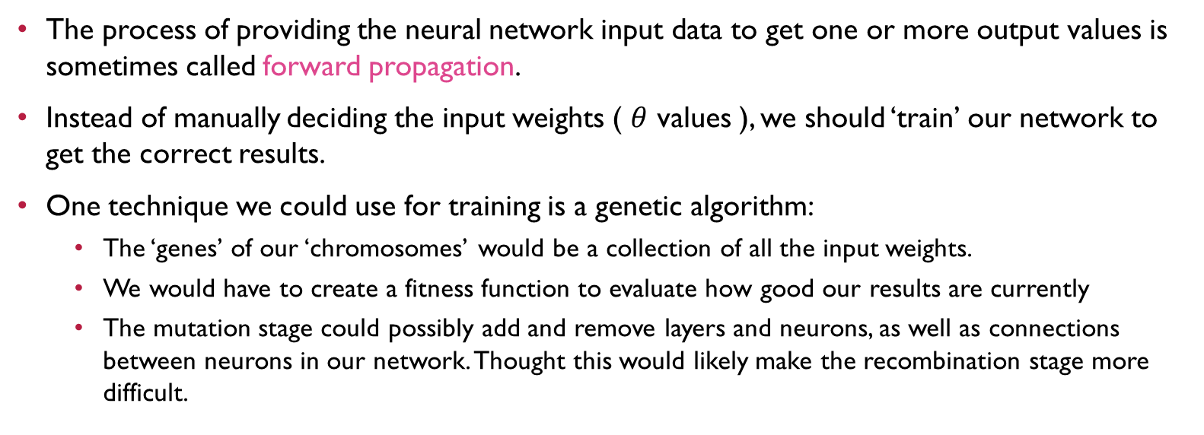
Neural Networks - Learning
The process of providing the neural network input data to get one or more output values is sometimes called forward propagation.
Instead of manually deciding the input weights ( $θ$ values ), we should ‘train’ our network to get the correct results.
One technique we could use for training is a genetic algorithm:
The ‘genes’ of our ‘chromosomes’ would be a collection of all the input weights.
We would have to create a fitness function to evaluate how good our results are currently
The mutation stage could possibly add and remove layers and neurons, as well as connections between neurons in our network. Thought this would likely make the recombination stage more difficult.

Slide 11
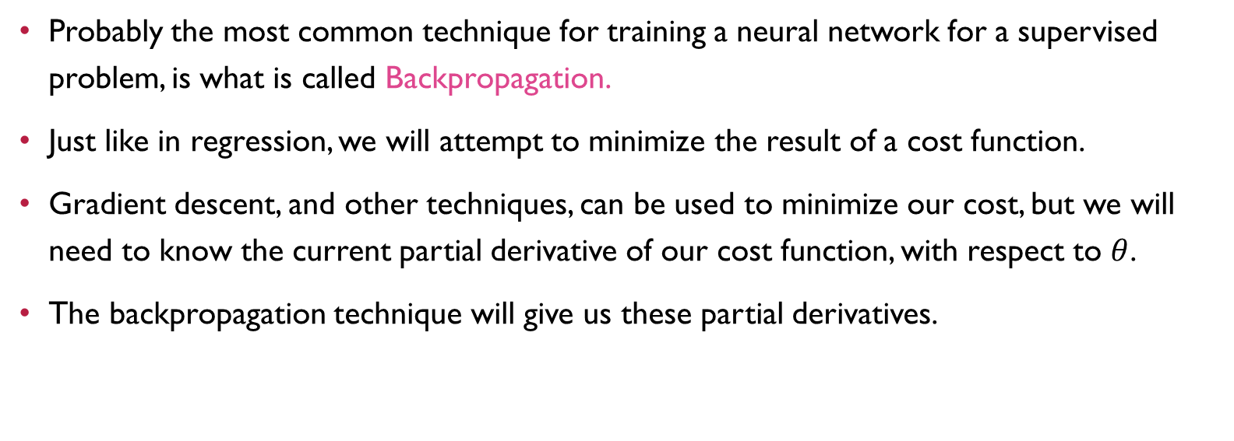
Neural Networks - Learning
Probably the most common technique for training a neural network for a supervised problem, is what is called Backpropagation.
Just like in regression, we will attempt to minimize the result of a cost function.
Gradient descent, and other techniques, can be used to minimize our cost, but we will need to know the current partial derivative of our cost function, with respect to $θ$.
The backpropagation technique will give us these partial derivatives.

Slide 12
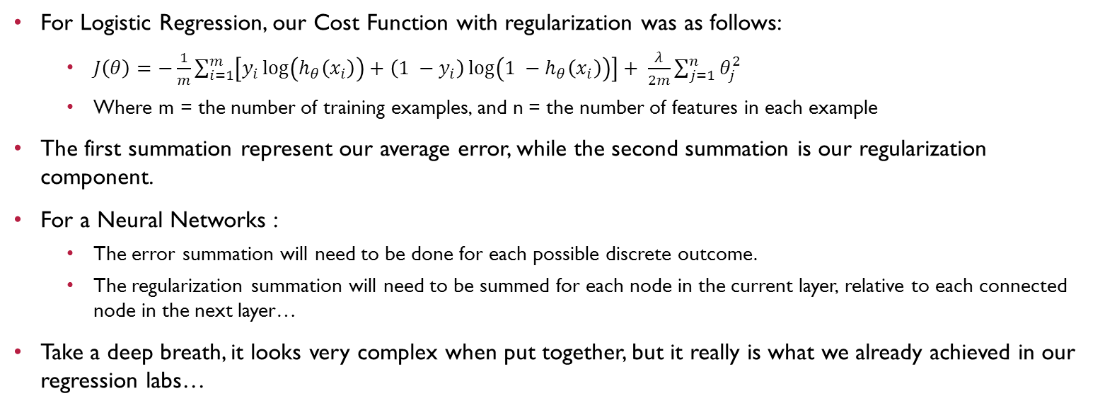
Neural Network – Cost Function
For Logistic Regression, our Cost Function with regularization was as follows:
$J\left(θ\right)=−\frac{1}{m}\sum_{i=1}^{m}{\left[y_{i}\log\left(h_{θ}\left(x_{i}\right)\right)+\left(1 −y_{i}\right)\log\left(1 −h_{θ}\left(x_{i}\right)\right)\right]}+ \frac{λ}{2m}\sum_{j=1}^{n}{θ_{j}^{2}}$
Where m = the number of training examples, and n = the number of features in each example
The first summation represent our average error, while the second summation is our regularization component.
For a Neural Networks :
The error summation will need to be done for each possible discrete outcome.
The regularization summation will need to be summed for each node in the current layer, relative to each connected node in the next layer…
Take a deep breath, it looks very complex when put together, but it really is what we already achieved in our regression labs…

Slide 13
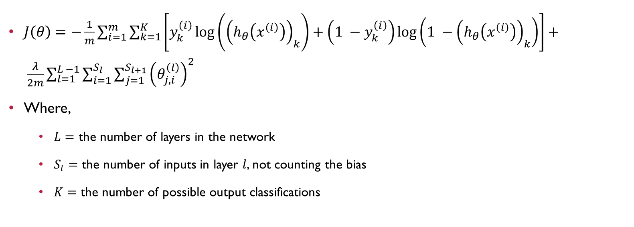
Neural Network – Cost Function
$J\left(θ\right)=−\frac{1}{m}\sum_{i=1}^{m}{\sum_{k=1}^{K}{\left[y_{k}^{\left(i\right)}\log\left({\left(h_{θ}\left(x^{\left(i\right)}\right)\right)}_{k}\right)+\left(1 −y_{k}^{\left(i\right)}\right)\log\left(1 −{\left(h_{θ}\left(x^{\left(i\right)}\right)\right)}_{k}\right)\right]}}+ \frac{λ}{2m}\sum_{l=1}^{L −1}{\sum_{i=1}^{S_{l}}{\sum_{j=1}^{S_{l+1}}{{\left(θ_{j,i}^{\left(l\right)}\right)}^{2}}}}$
Where,
$L=$ the number of layers in the network
$S_{l}=$ the number of inputs in layer $l$, not counting the bias
$K=$ the number of possible output classifications

Slide 14
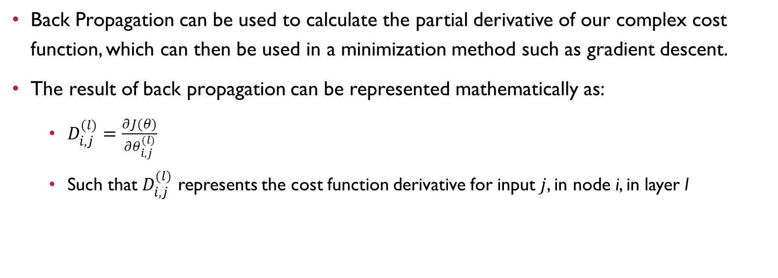
Neural Networks – Back Propagation
Back Propagation can be used to calculate the partial derivative of our complex cost function, which can then be used in a minimization method such as gradient descent.
The result of back propagation can be represented mathematically as:
$D_{i, j}^{(l)}=\frac{∂J(θ)}{∂θ_{i, j}^{(l)}}$
Such that $D_{i, j}^{(l)}$ represents the cost function derivative for input $j$, in node i, in layer l

Slide 15
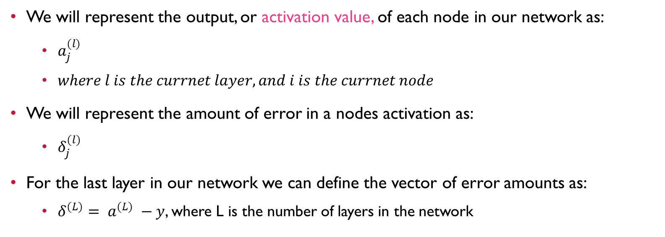
Neural Networks – Back Propagation
We will represent the output, or activation value, of each node in our network as:
$a_{j}^{(l)}$
$where l is the currnet layer, and i is the currnet node$
We will represent the amount of error in a nodes activation as:
$δ_{j}^{(l)}$
For the last layer in our network we can define the vector of error amounts as:
$δ^{(L)}= a^{(L)} −y$, where L is the number of layers in the network

Slide 16
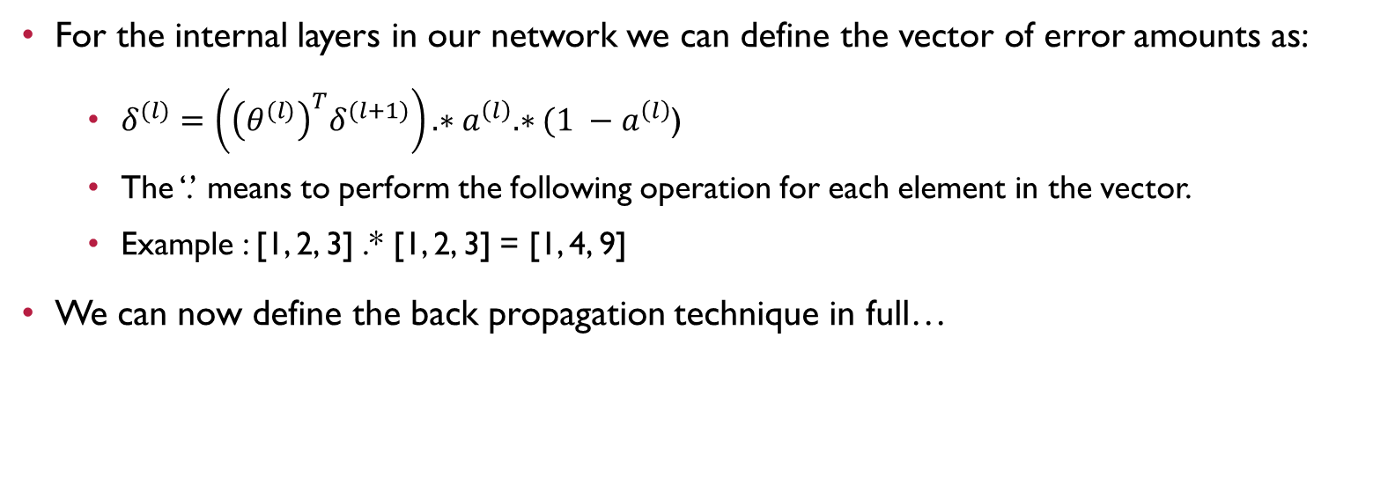
Neural Networks – Back Propagation
For the internal layers in our network we can define the vector of error amounts as:
$δ^{(l)}=\left({\left(θ^{(l)}\right)}^{T}δ^{(l+1)}\right).∗a^{\left(l\right)}.∗(1 −a^{\left(l\right)}$)
The ‘.’ means to perform the following operation for each element in the vector.
Example : [1, 2, 3] .* [1, 2, 3] = [1, 4, 9]
We can now define the back propagation technique in full…

Slide 17
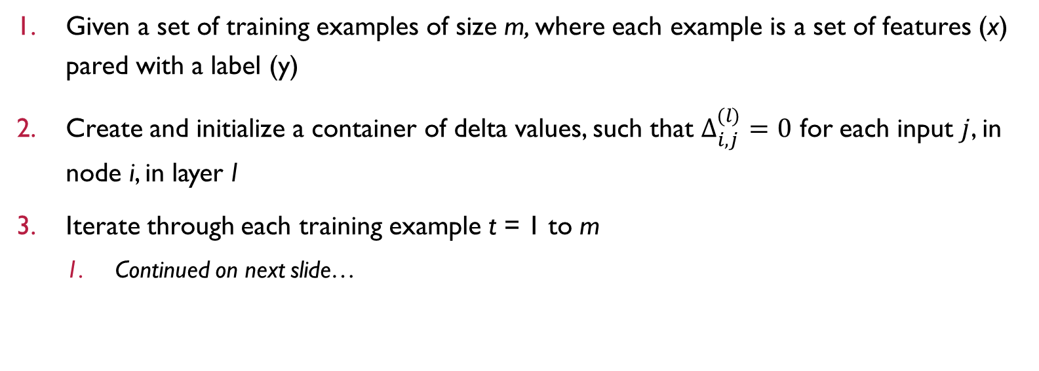
Neural Networks – Back Propagation steps
Given a set of training examples of size m, where each example is a set of features (x) pared with a label (y)
Create and initialize a container of delta values, such that $Δ_{i, j}^{(l)}=0$ for each input $j$, in node i, in layer l
Iterate through each training example t = 1 to m
Continued on next slide…

Slide 18
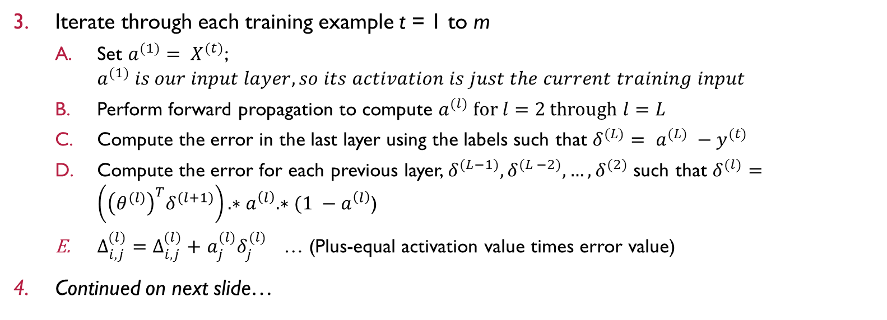
Neural Networks – Back Propagation steps
Iterate through each training example t = 1 to m
Set $a^{(1)}= X^{(t)}$; $a^{(1)} is our input layer, so its activation is just the current training input$
Perform forward propagation to compute $a^{(l)} for l=2 through l=L$
Compute the error in the last layer using the labels such that $δ^{(L)}= a^{(L)} −y^{(t)}$
Compute the error for each previous layer, $δ^{(L−1)},δ^{(L −2)}, …,δ^{(2)}$ such that $δ^{(l)}=\left({\left(θ^{(l)}\right)}^{T}δ^{(l+1)}\right).∗a^{\left(l\right)}.∗(1 −a^{\left(l\right)}$)
$Δ_{i, j}^{(l)}=Δ_{i, j}^{(l)}+$ $a_{j}^{(l)}δ_{j}^{(l)}$ … (Plus-equal activation value times error value)
Continued on next slide…

Slide 19
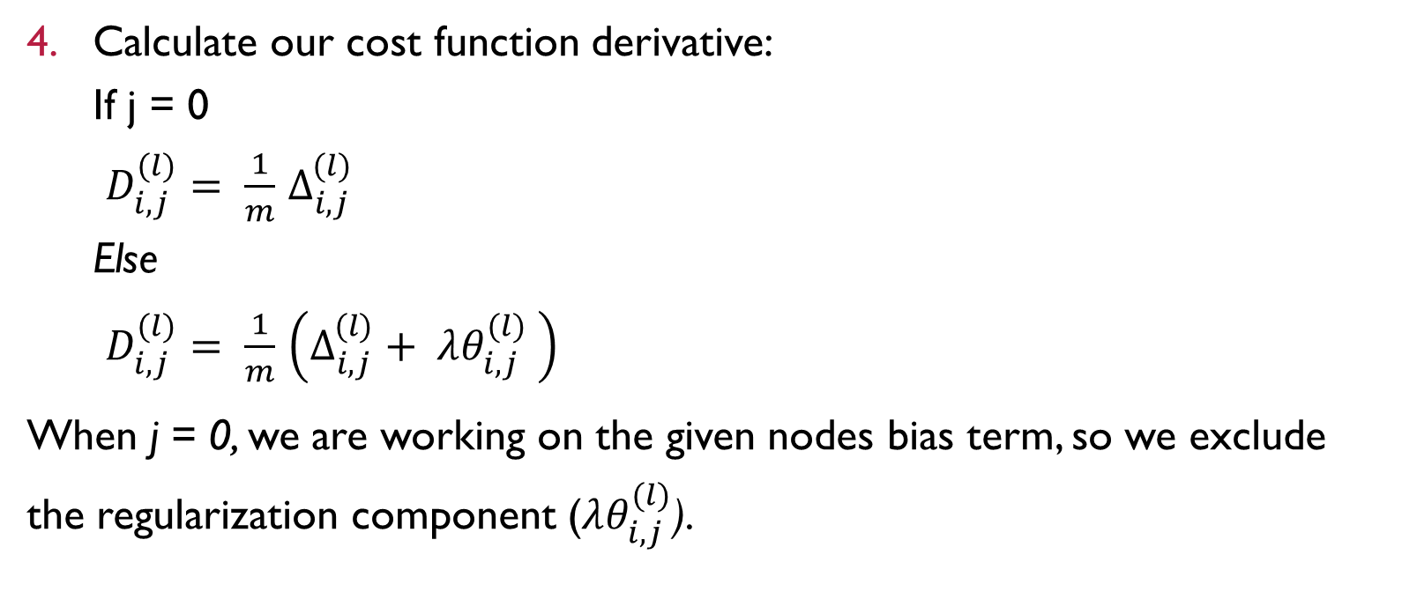
Neural Networks – Back Propagation steps
Calculate our cost function derivative: If j = 0 $D_{i, j}^{(l)}= \frac{1}{m}$ $Δ_{i, j}^{(l)}$ Else $D_{i, j}^{(l)}= \frac{1}{m}$ $\left(Δ_{i, j}^{(l)}+ λθ_{i, j}^{(l)} \right)$
When j = 0, we are working on the given nodes bias term, so we exclude the regularization component ($λθ_{i, j}^{(l)}$).

Slide 20
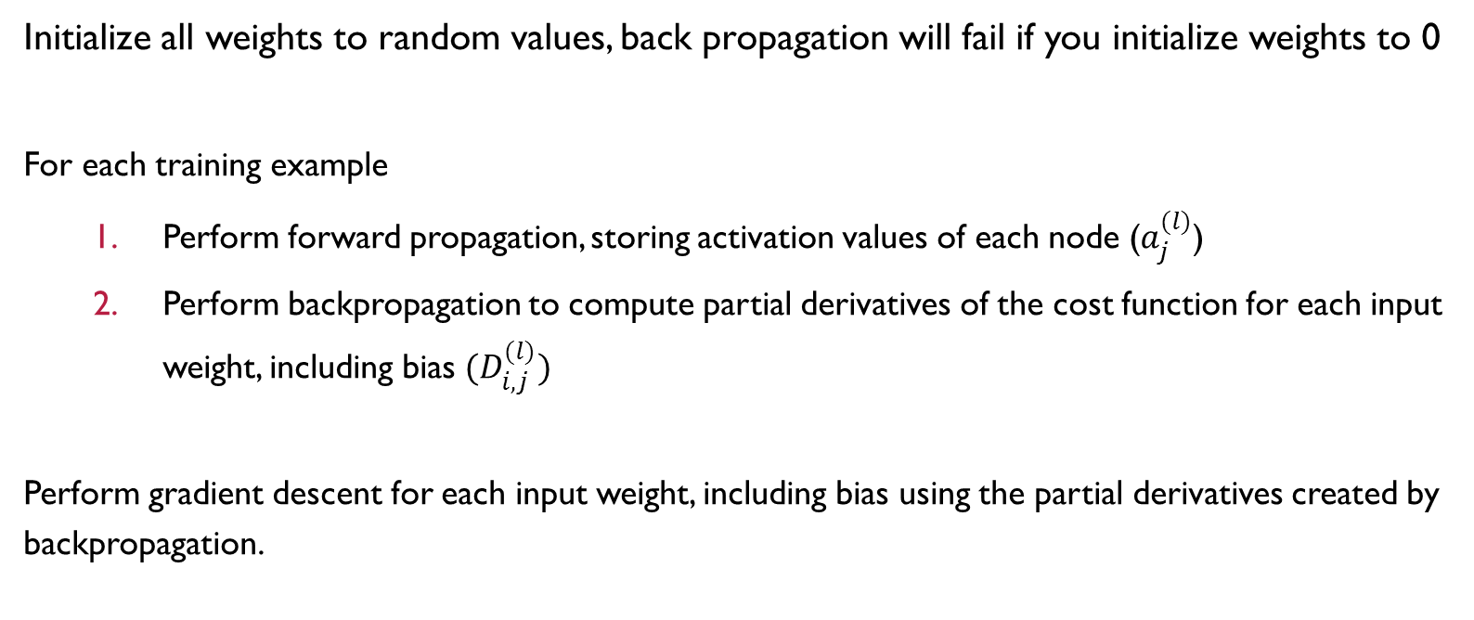
Neural Network – Batch Training Steps
Initialize all weights to random values, back propagation will fail if you initialize weights to 0
For each training example
Perform forward propagation, storing activation values of each node ($a_{j}^{(l)}$)
Perform backpropagation to compute partial derivatives of the cost function for each input weight, including bias ${(D}_{i, j}^{(l)})$
Perform gradient descent for each input weight, including bias using the partial derivatives created by backpropagation.

Slide 21
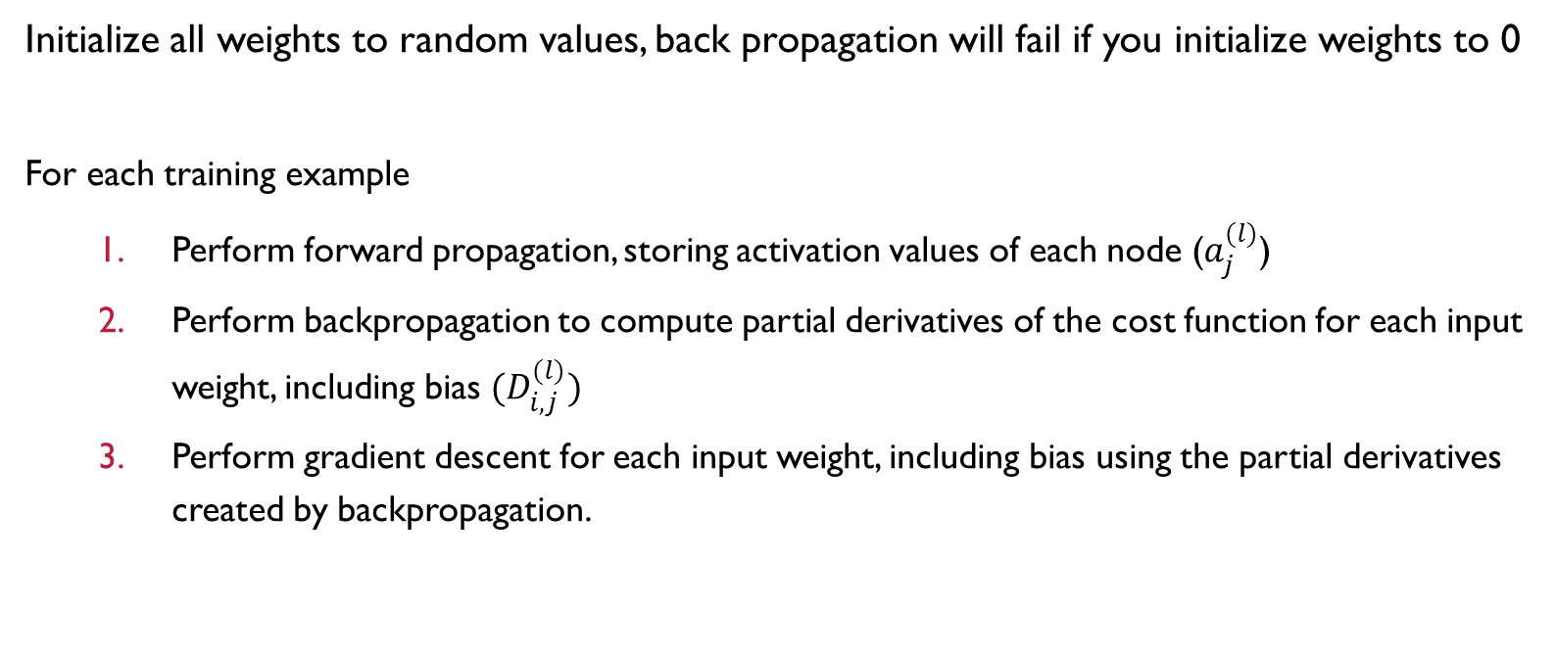
Neural Network – Sequential Training Steps
Initialize all weights to random values, back propagation will fail if you initialize weights to 0
For each training example
Perform forward propagation, storing activation values of each node ($a_{j}^{(l)}$)
Perform backpropagation to compute partial derivatives of the cost function for each input weight, including bias ${(D}_{i, j}^{(l)})$
Perform gradient descent for each input weight, including bias using the partial derivatives created by backpropagation.

